Slide 1
Poster Title here
Notes:
Three Column Poster default

Slide 2
Notes:
Three Column Poster Layout

Slide 3
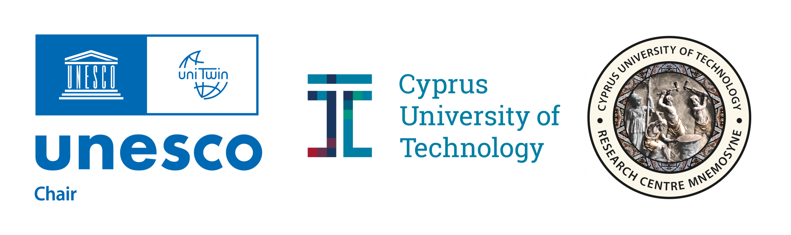
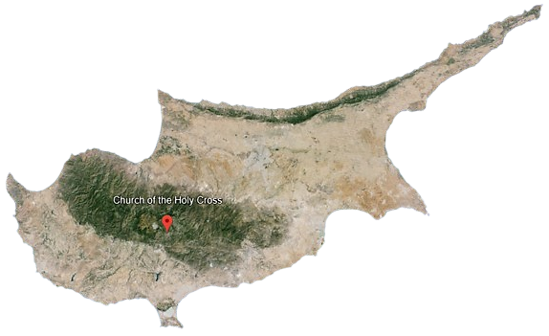

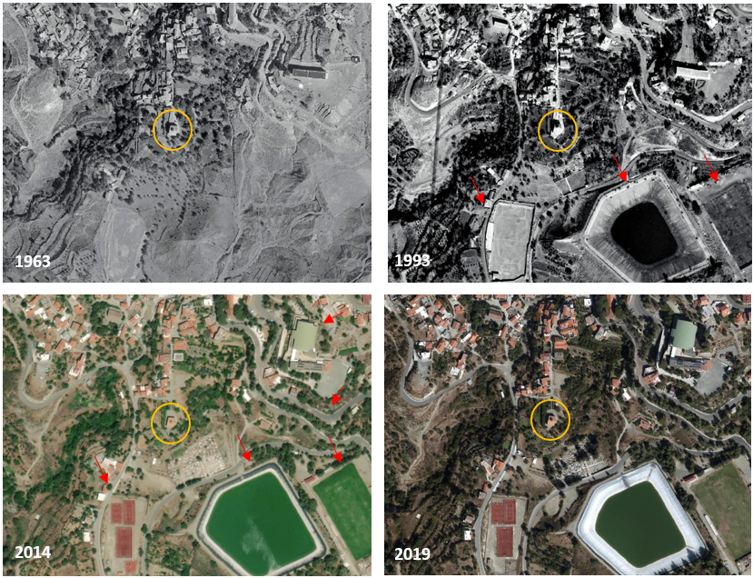

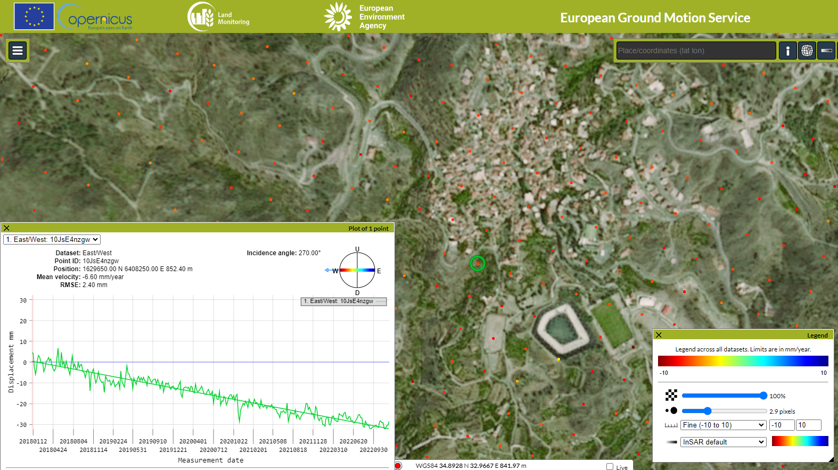
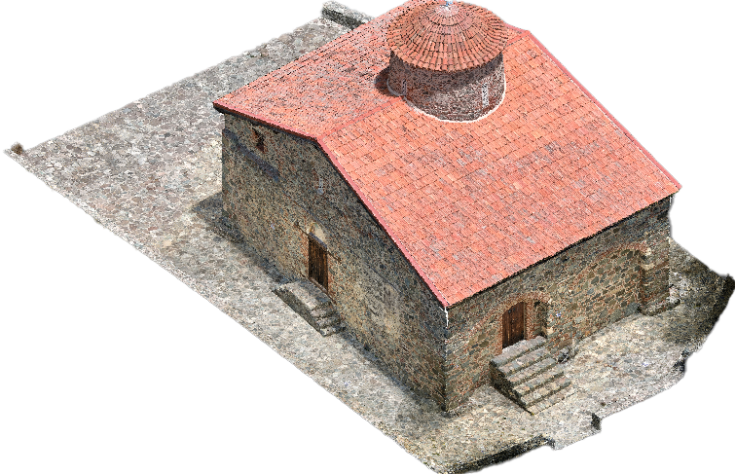


Space-to-Ground Documentation & Monitoring of Cultural Heritage
Agapiou, A., Ioannides, M., Siegkas, P., Patsalides, S., Baker, D. & Dionysiou M.
Digital Cultural Heritage Research Centre MNEMOSYNE, Cyprus University of Technology, Limassol, Cyprus
Church of the Holy Cross
Earth Observation data and visualisations courtesy of the Copernicus Data Space Ecosystem and Copernicus Service information 2024 under ESA non-commercial use open access policy
1. Preserving a Legacy
In the heart of Cyprus lies the revered UNESCO site, Holy Cross Church at Pelendri, a symbol of rich cultural heritage. Utilising advanced space-to ground documentation and monitoring, we embark on a journey to preserve and understand this historical treasure.
Through the use of advanced technologies, we ensure comprehensive documentation of the monument, capturing both its physical attributes and intangible significance. This holistic approach guarantees the continued safeguarding of this monument, ensuring its legacy endures for generations to come.
3. Landscape Changes Over Time
4. Digital Surveying Advancements
To safeguard the preservation of cultural heritage monuments like the Holy Cross Church, it is crucial for local authorities and responsible stakeholders to collaborate in implementing appropriate planning and zoning regulations. This helps strike a balance between development and preservation, ensuring that the natural and historical character of the area is respected while allowing for sustainable growth and enhancement of the surrounding landscape. To this end, the surrounding area of the monument was examined through a timeseries of orthophotos produced by the Department of Land and Surveys, dated back to 1963 aiming to understand the impact of landscape changes over time. The overall findings indicate some significant land use changes in the southern part of the Church.
Data were also retrieved from European Ground Motion Service (EGMS) and studied to detect possible land movements occurred in the area that may affect the integrity of the monument. Through Sentinel 1 and InSAR analysis from the EGMS it was possible to capture the overall subsidence of the area.
In our pursuit to preserve the rich heritage of the monument, innovative digital surveying methods have been employed. Through a combination of Photogrammetry and Terrestrial Laser Scanning (TLS), a comprehensive digital record of this monument has been crafted. By aligning georeferenced point cloud data from Photogrammetry with TLS, we pave the way for enhanced data processing within Building Information Modelling (BIM) software
2. The Church of the Holy Cross:
An Evolutionary Journey
The Church of the Holy Cross in Pelendri has undergone a remarkable evolution, shaped by centuries of interventions. Originally a single-aisled dome hall church in the 12th century, adorned with frescoes in 1178, subsequent alterations transformed its structure. Collapse and reconstruction led to the integration of the original apse into a new church in the 14th century. Further modifications in the 16th century included additions to the north chapel. Structural challenges resulted in collapses, leaving remnants of frescoes on surviving walls. Each layer of change adds to the rich tapestry of history within this sacred site.
5. Building a Bridge to the Future
with HBIM and MemoryTwins
Our mission extends beyond documentation; we aspire to create a Historical Building Information Modelling (HBIM) model of the Holy Cross Church. This model will not only capture architectural qualities but also incorporate crucial attributes such as paradata, metadata, and data.
This project has received funding from the European Union’s Horizon Europe Framework Programme
(HORIZON-WIDERA-2021-ACCESS-03, Twinning Call) under the grant agreement No 101079377 & the UKRI under project number 10050486.
EUreka3D project is co-financed by the Digital Europe Programme of the European Union, GA n. 101100685
Dr Athos Agapiou
Email: athos.agapiou@cut.ac.cy
Web: https://digitalheritagelab.eu
Notes:
Three Column Poster Example

